Slide 1

Programming with Python
Chapter 10

Slide 2
Threads and Processes
Time-sharing systems (late 1950s – early 1960s)
Allowed several programs to run concurrently on a single computer
Multiprocessing systems (1980s)
A single user running several programs at once
Networked/distributed systems (1980s –1990s)
Processes began to be distributed across several CPUs linked by high-speed communication lines
Parallel systems
Run a single program on several CPUs at once

Slide 3
Threads
In Python, a thread is an object like any other in that it can hold data, be run with methods, be stored in data structures, and be passed as parameters to methods
A thread can also be executed as a process
Before it can execute, a thread’s class must implement a run method
During its lifetime, a thread can be in various states

Slide 4
Threads

Slide 5
Threads
A thread remains inactive until start method runs
Thread is placed in the ready queue
Newly started thread’s run method is also activated
A thread can lose access to the CPU:
Time-out (process also known as time slicing)
Sleep
Block
Wait
Process of saving/restoring a thread’s state is called a context switch

Slide 6
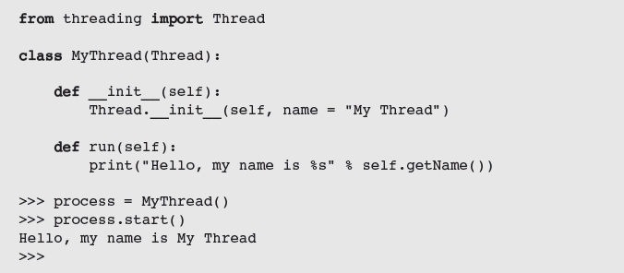
Threads
Most common way to create a thread is to define a class that extends the class threading.Thread

Slide 7
Threads
A thread’s run method is invoked automatically by start

Slide 8
Sleeping Threads
The function time.sleep puts a thread to sleep for the specified number of seconds

Slide 9
Producer, Consumer, and Synchronization
Threads that interact by sharing data are said to have a producer/consumer relationship
Example: an assembly line in a factory
A producer must produce each item before a consumer consumes it
Each item must be consumed before the producer produces the next item
A consumer must consume each item just once
We will simulate a producer/consumer relationship:
Will share a single data cell with an integer

Slide 10
Producer, Consumer, and Synchronization
Threads sleep for random intervals

Slide 11
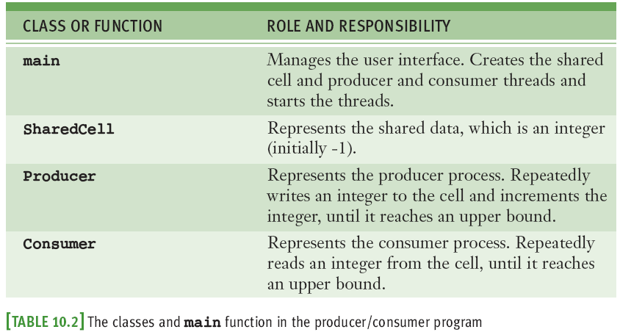
Producer, Consumer, and Synchronization

Slide 12
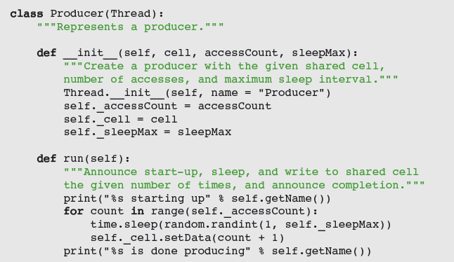
Producer, Consumer, and Synchronization

Slide 13
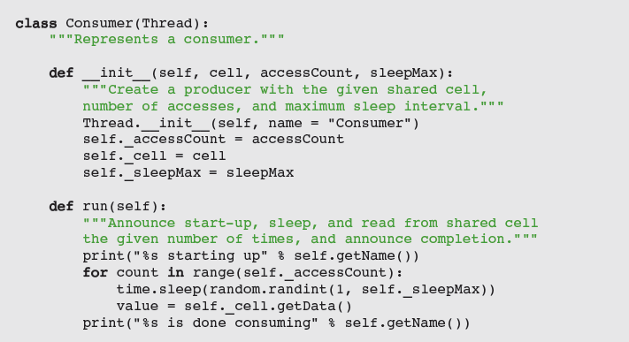
Producer, Consumer, and Synchronization

Slide 14
Producer, Consumer, and Synchronization
Synchronization problems may arise:
Consumer accesses the shared cell before the producer has written its first datum
Producer then writes two consecutive data (1 and 2) before the consumer has accessed the cell again
Consumer accesses data 2 twice
Producer writes data 4 after consumer is finished
Solution: synchronize producer/consumer threads
States of shared cell: writeable or not writeable

Slide 15
Producer, Consumer, and Synchronization
Solution (continued):
Add two instance variables to SharedCell: a Boolean flag (_writeable) and an instance of threading.Condition
A Condition maintains a lock on a resource
Pattern for accessing a resource with a lock:
Run acquire on the condition.
While it’s not OK to do the work
Run wait on the condition.
Do the work with the resource.
Run notify on the condition.
Run release on the condition.

Slide 16
Producer, Consumer, and Synchronization

Slide 17
Networks, Clients, and Servers
Clients and servers are applications or processes that can run locally on a single computer or remotely across a network of computers
The resources required for this type of application are:
IP addresses
Sockets
Threads

Slide 18
IP Addresses
A computer on a network has a unique identifier called an IP address (IP: Internet Protocol)
Can be specified as an IP number
Format: ddd.ddd.ddd.ddd (d is a digit, IPv4)
Example: 137.112.194.77
Or, as an IP name
Example: lambertk
Python’s socket module includes two functions that can look up these items of information

Slide 19
IP Addresses
May raise exceptions;
to avoid, embed in a
try-except statement
You may use ' localhost‘ (127.0.0.1) for testing

Slide 20
Ports, Servers, and Clients
Clients connect to servers via ports
Serve as a channel through which several clients can exchange data with the same server or with different servers
Usually specified by numbers
Some are dedicated to special servers or tasks
Example: 13 for the day/time server or 80 for a Web server
Most computers also have hundreds or even thousands of free ports available for use by any network applications

Slide 21
Sockets and a Day/Time Client Script
We’ll write a script that is a client to a server
Socket: object that serves as a communication link between a server process and a client process
Can create/open several sockets on the same port

Slide 22
A Day/Time Server Script
You can write a day/time server script in Python to handle requests from many clients
The basic sequence of operations for a simple day/time server script is:
Create a socket and open it on port 5000 of the local host
While true:
Wait for a connection from a client
When the connection is made, send the date to the client

Slide 23
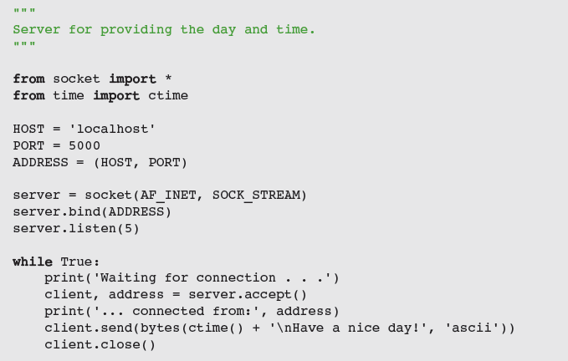
A Day/Time Server Script

Slide 24
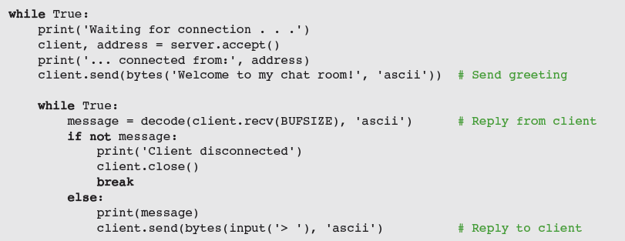
A Two-Way Chat Script
Server creates a socket and enters an infinite loop to accept/handle clients; when one connects, it sends a greeting, and enters loop to chat with client

Slide 25
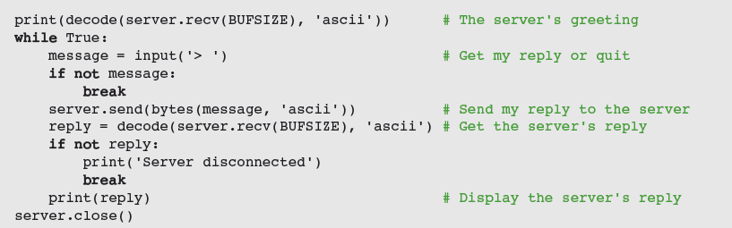
A Two-Way Chat Script
Client:
Sets up a socket
After connection, receives and displays greeting
Then, enters a loop to chat with server

Slide 26
Handling Multiple Clients Concurrently
To solve the problem of giving many clients timely access to the server, we assign task of handling the client’s request a client-handler thread

Slide 27
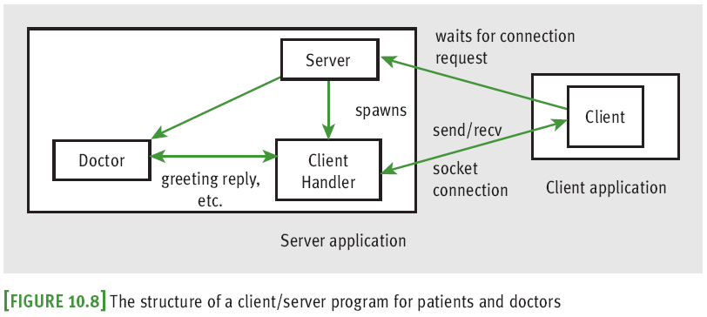
Setting Up Conversations for Others
How can we support multiple two-way chats?

Slide 28
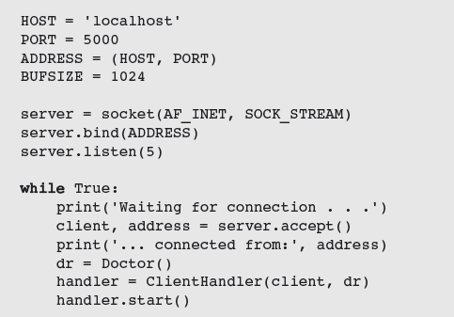
Setting Up Conversations for Others

Slide 29
Case Study: A Multi-Client Chat Room
Request:
Write a program that supports an online chat room
Analysis:
When a client connects, sever sends a record of conversation so far in the following format:
<day/time> <user name>
<message>

Slide 30
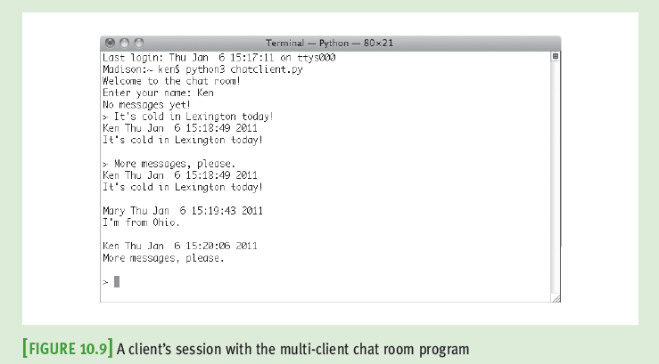
Case Study: A Multi-Client Chat Room

Slide 31
Case Study: A Multi-Client Chat Room
Design:
Program’s structure and behavior are similar to those of the online therapy server described earlier
However, instead of communicating with a single autonomous software agent, a client communicates with the other clients
Share a common record/transcript of the conversation

Slide 32
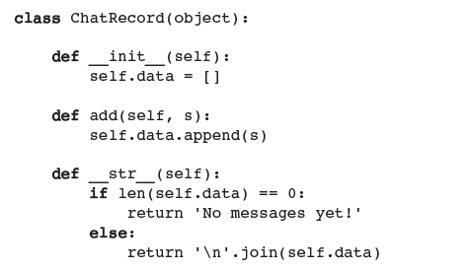
Case Study: Multi-Client Chat Room Implementation

Slide 33
Summary
Threads allow the work of a single program to be distributed among several computational processes
States: born, ready, executing, sleeping, and waiting
After a thread is started, it goes to the end of the ready queue to be scheduled for a turn in the CPU
A thread may give up CPU when timed out, sleeps, waits on a condition, or finishes its run method
When a thread wakes up, is timed out, or is notified that it can stop waiting, it returns to the rear of the ready queue

Slide 34
Summary
Thread synchronization problems can occur when two or more threads share data
Each computer on a network has a unique IP address that allows other computers to locate it
Servers and clients communicate on a network by sending bytes through their socket connections
A server can handle several clients concurrently by assigning each client request to a separate handler thread

